Slide 1
Heuristics

Slide 2
Heuristic
Proceeding to a solution by trial and error or by rules that are only loosely defined.

Slide 3
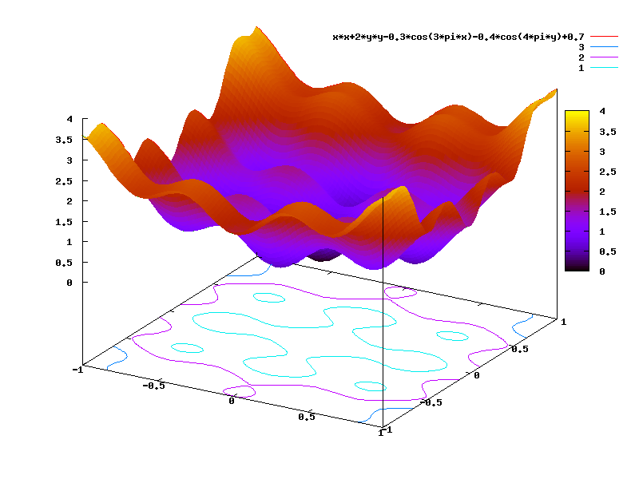
Find Min/Max Value of Function
https://commons.wikimedia.org/wiki/File:B2_optimization_function.png

Slide 4
Heuristics
Find feasible solution(s)
Perform operation on solution pool
Evaluate new solutions to decide if new solutions better

Slide 5
Heuristics
Usually have a random component
Usually iterative algorithms
Usually biomimicry (or inspired by other physical systems)
Often find Pareto frontier rather than optimal value

Slide 6
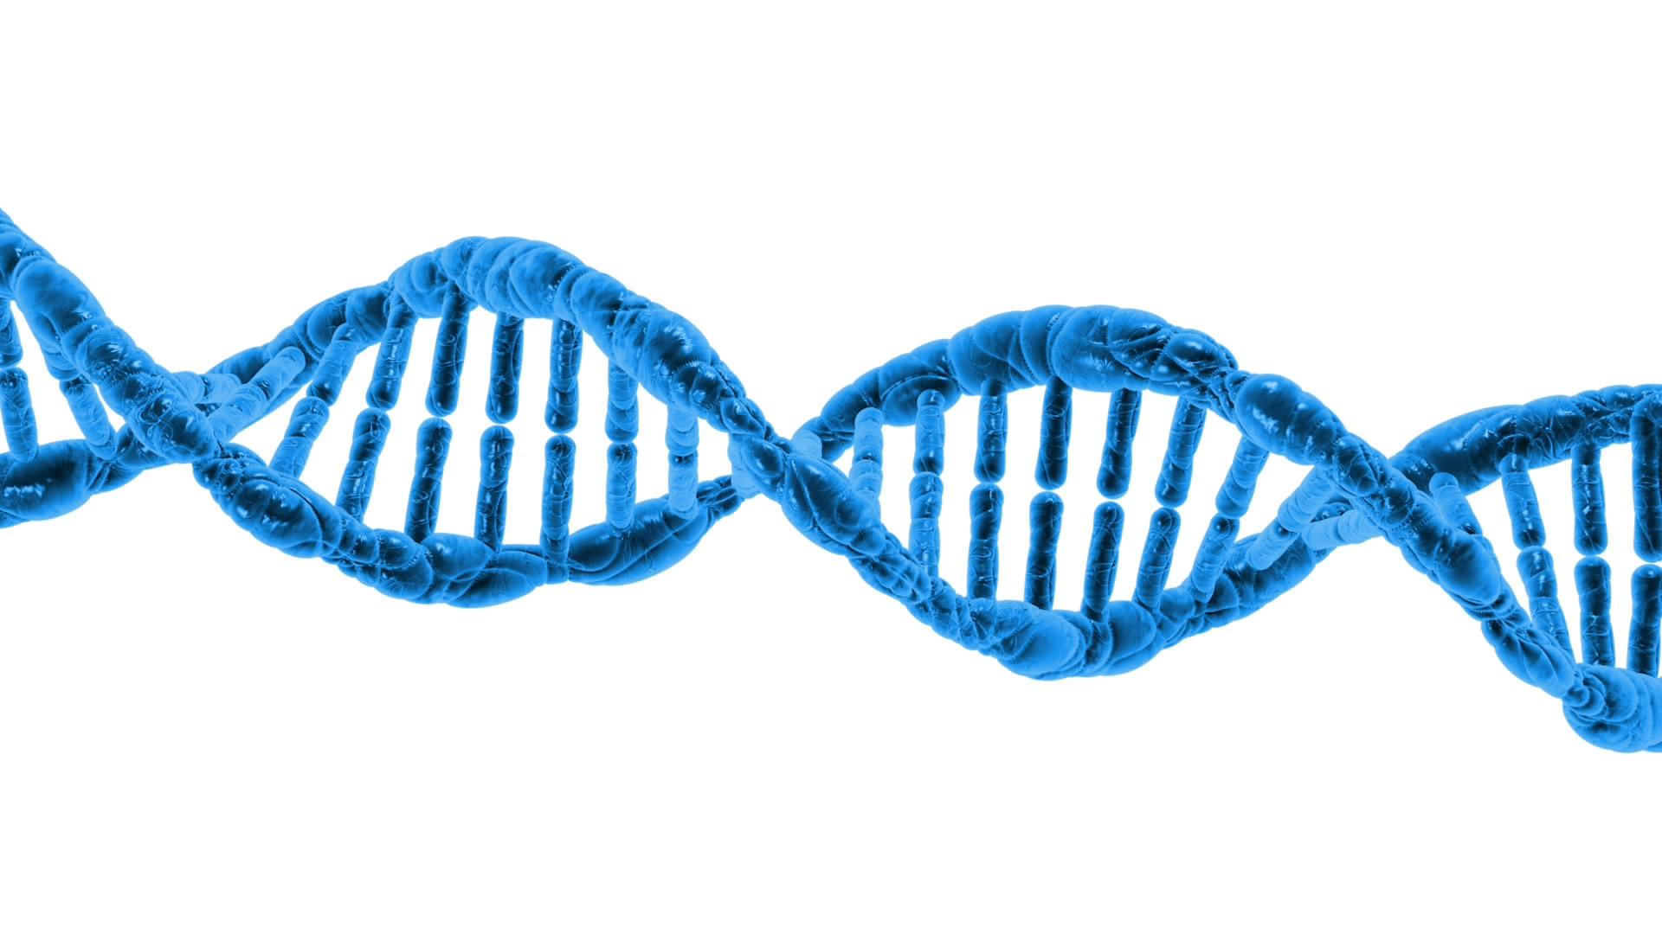
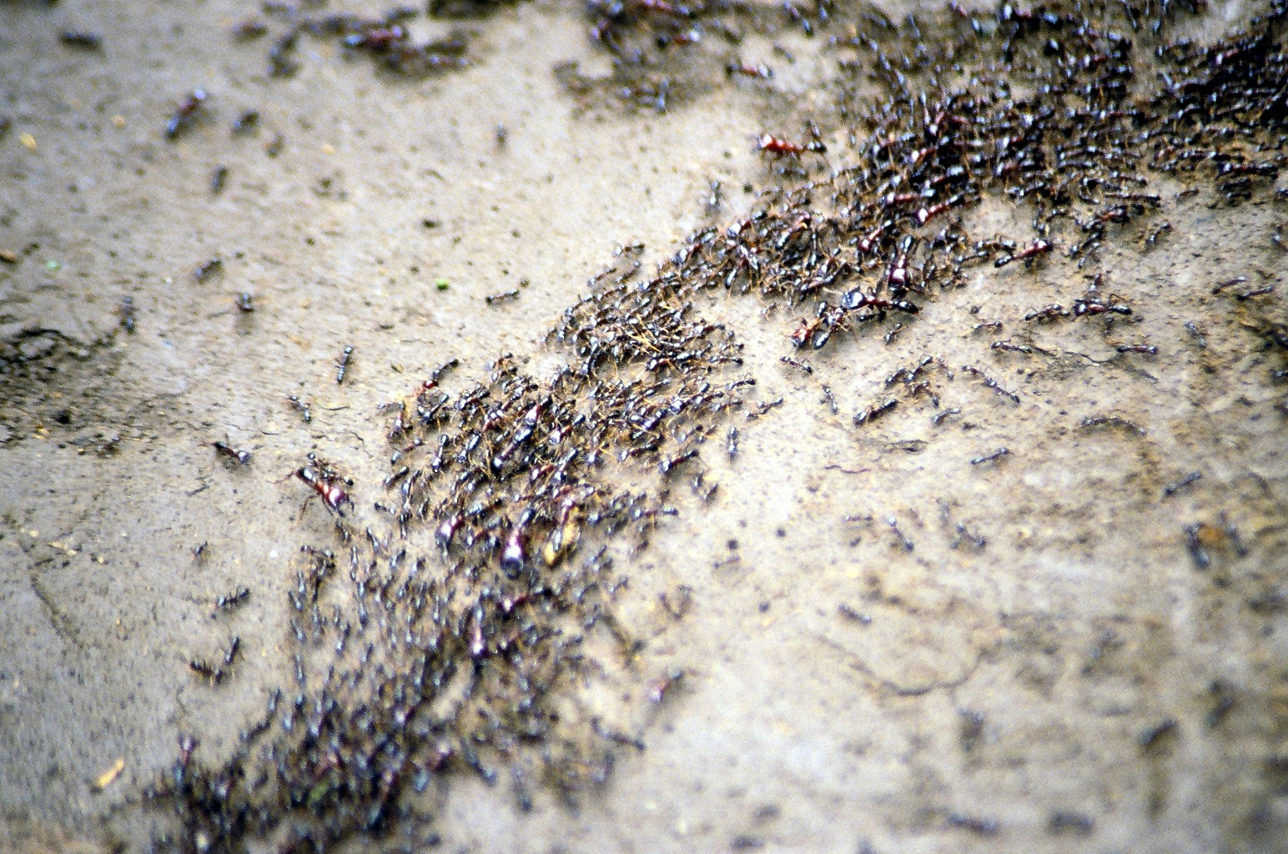
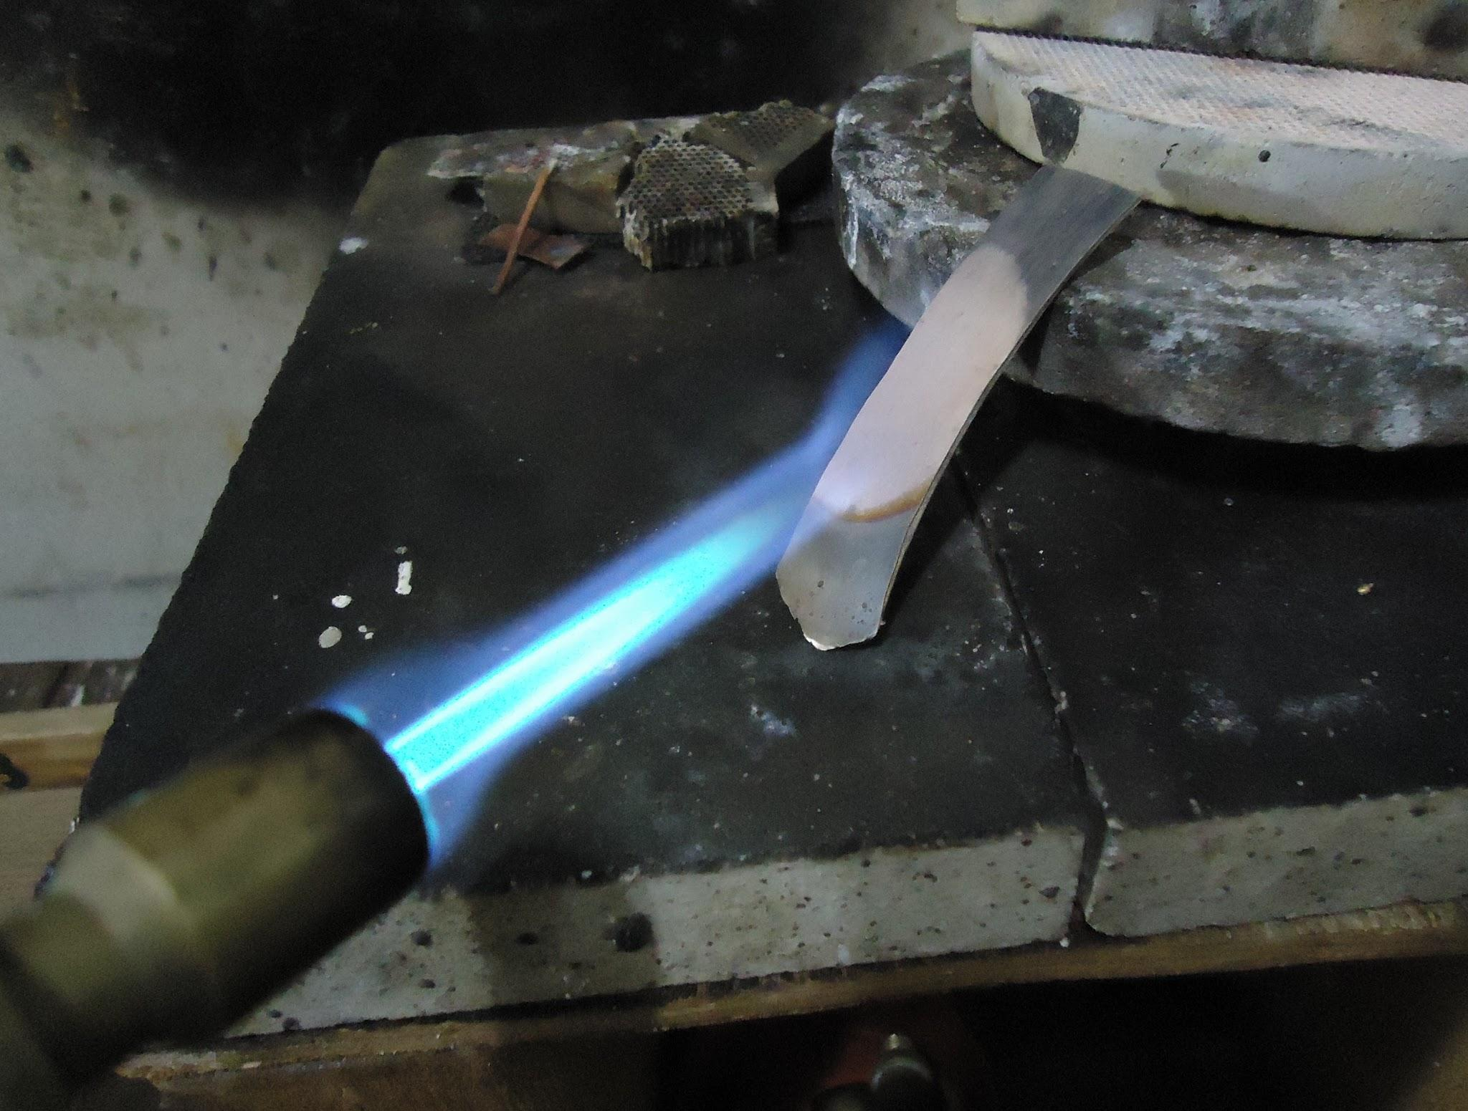
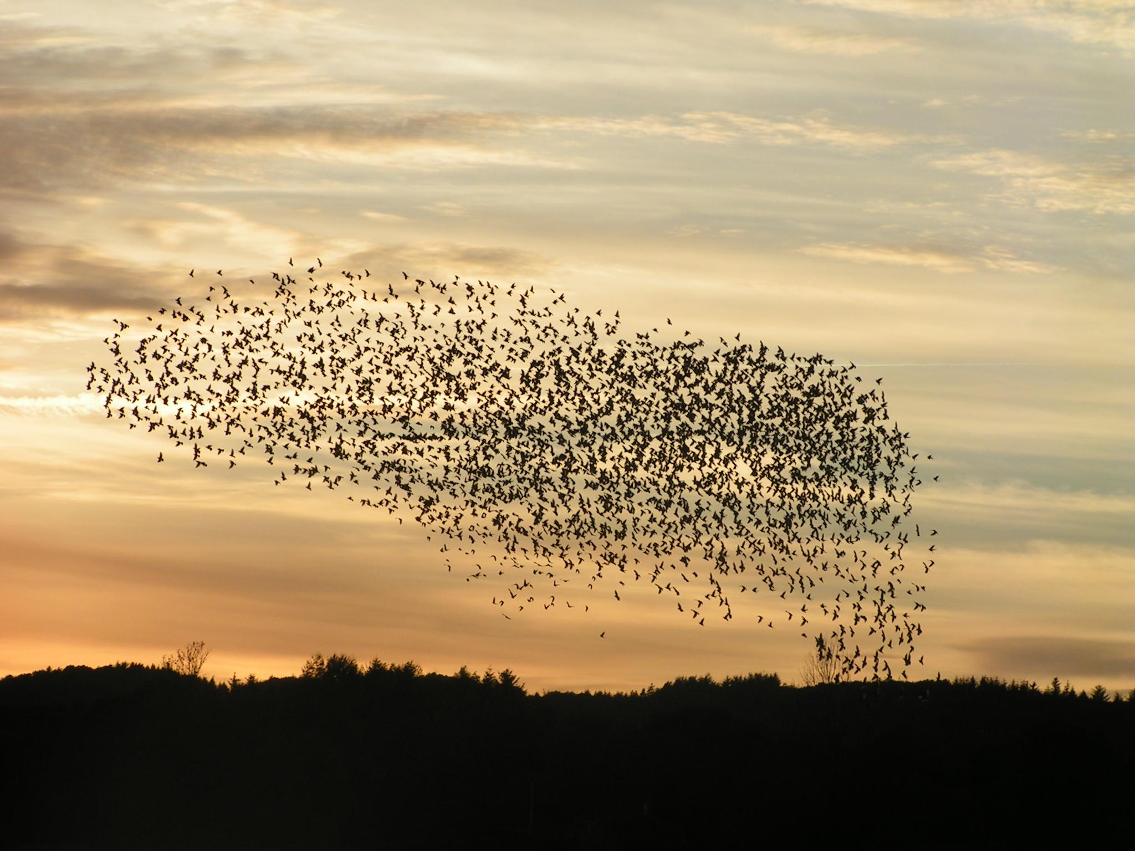
Heuristics
https://commons.wikimedia.org/wiki/File:Annealing_a_silver_strip.JPG
https://commons.wikimedia.org/wiki/File:Safari_ants.jpg
https://commons.wikimedia.org/wiki/File:Fugle,_%C3%B8rns%C3%B8_073.jpg
https://www.publicdomainpictures.net/en/view-image.php?image=42718&picture=dna
Notes:
Usually have a random component
Usually iterative algorithms
Usually biomimicry (or inspired by other physical systems)
Often find Pareto frontier rather than optimal value
Basically:
Find feasible solution(s)
Crossover/somehow change solution pool
Evaluate new solutions and decide where to move/which to eliminate

Slide 7
Deterministic Heuristics
Greedy
A*
“Best-First Search”

Slide 8
Greedy Algorithm
Start at a feasible solution
Check nearby
Head in the direction of best gain

Slide 9
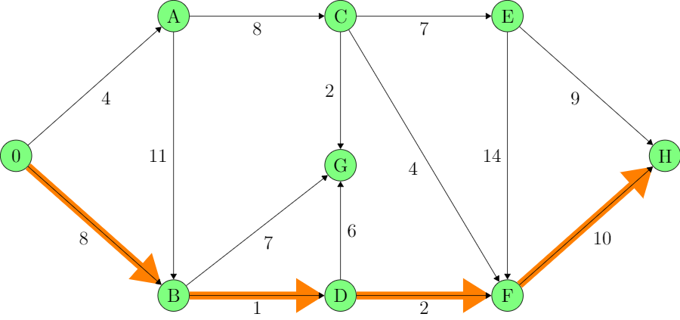
A*
Heuristic = smallest distance
from start + h(n)
where h(n) is a heuristic approximation (i.e. a guess) at how far away the goal is.
A | B | C | D | E | F | G | H
4 | 8 | 12 | 9 | ∞ | 11 | 15 | 21
Notes:
Common heuristic : straight-line distance

Slide 10
A*
Heuristic = smallest distance
from start + h(n)
h(n) must always UNDERestimate
Under this assumption, complete
h(x) ≤ d(x,y) + h(y)
Under this assumption, optimal
A | B | C | D | E | F | G | H
4 | 8 | 12 | 9 | ∞ | 11 | 15 | 21

Slide 11
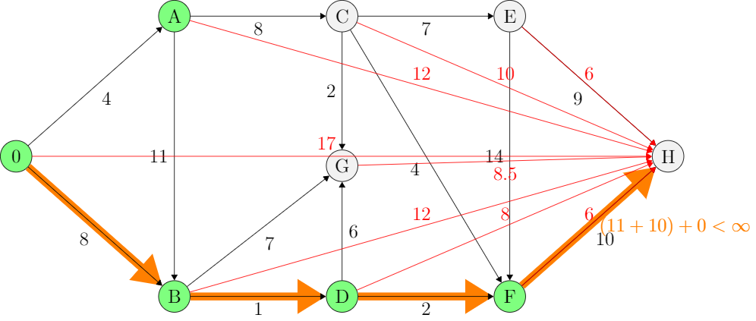
A*
d(n) + h(n)
h(n) = straight-line distance to H
A | B | C | D | E | F | G | H
4 | 8 | 12 (22) | 9 | ∞ | 11 | 15 (23.5) | 21 (21)

Slide 12
Stochastic Heuristics
Simulated Annealing
Genetic Algorithm
Differential Evolution
Particle Swarm/Ant Colony/Bee/Firefly Optimization

Slide 13
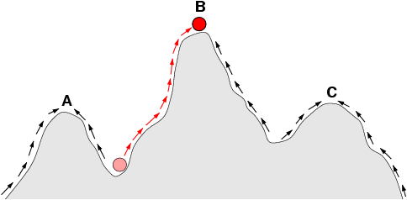
Simulated Annealing
https://commons.wikimedia.org/wiki/File:Fitness-landscape-cartoon.png
Notes:
Picture: standard hill-climber
Start at a feasible solution
Check nearby
Head in the direction of best gain
Simulated Annealing adds 3b
3b) With probability p, go in some other direction instead
Probability p is calculated via some function (usually exponential decay) of time; so that you are likely to try crazy stuff at beginning, very unlikely to at end
(drunk walk sobering up)

Slide 14
Simulated Annealing
Start at a feasible solution
Pick random direction
If better, head in that direction
With probability p, go in that direction even if it is worse
Value of p decreases as run continues!!

Slide 15
Simulated Annealing
https://en.wikipedia.org/wiki/Simulated_annealing#Pseudocode

Slide 16
Simulated Annealing
Pieces
Initialization
Find neighbor
Decide whether to go to this new point
e^{(best-new)/T}
Best and new scaled to [0,1]

Slide 17
Temperature Function
exp((old-new)/T)
T: determines “how hot” is the algorithm
Because in the denominator, it must be increasing
Linear measure of runtime is fine
[0 , 1]

Slide 18
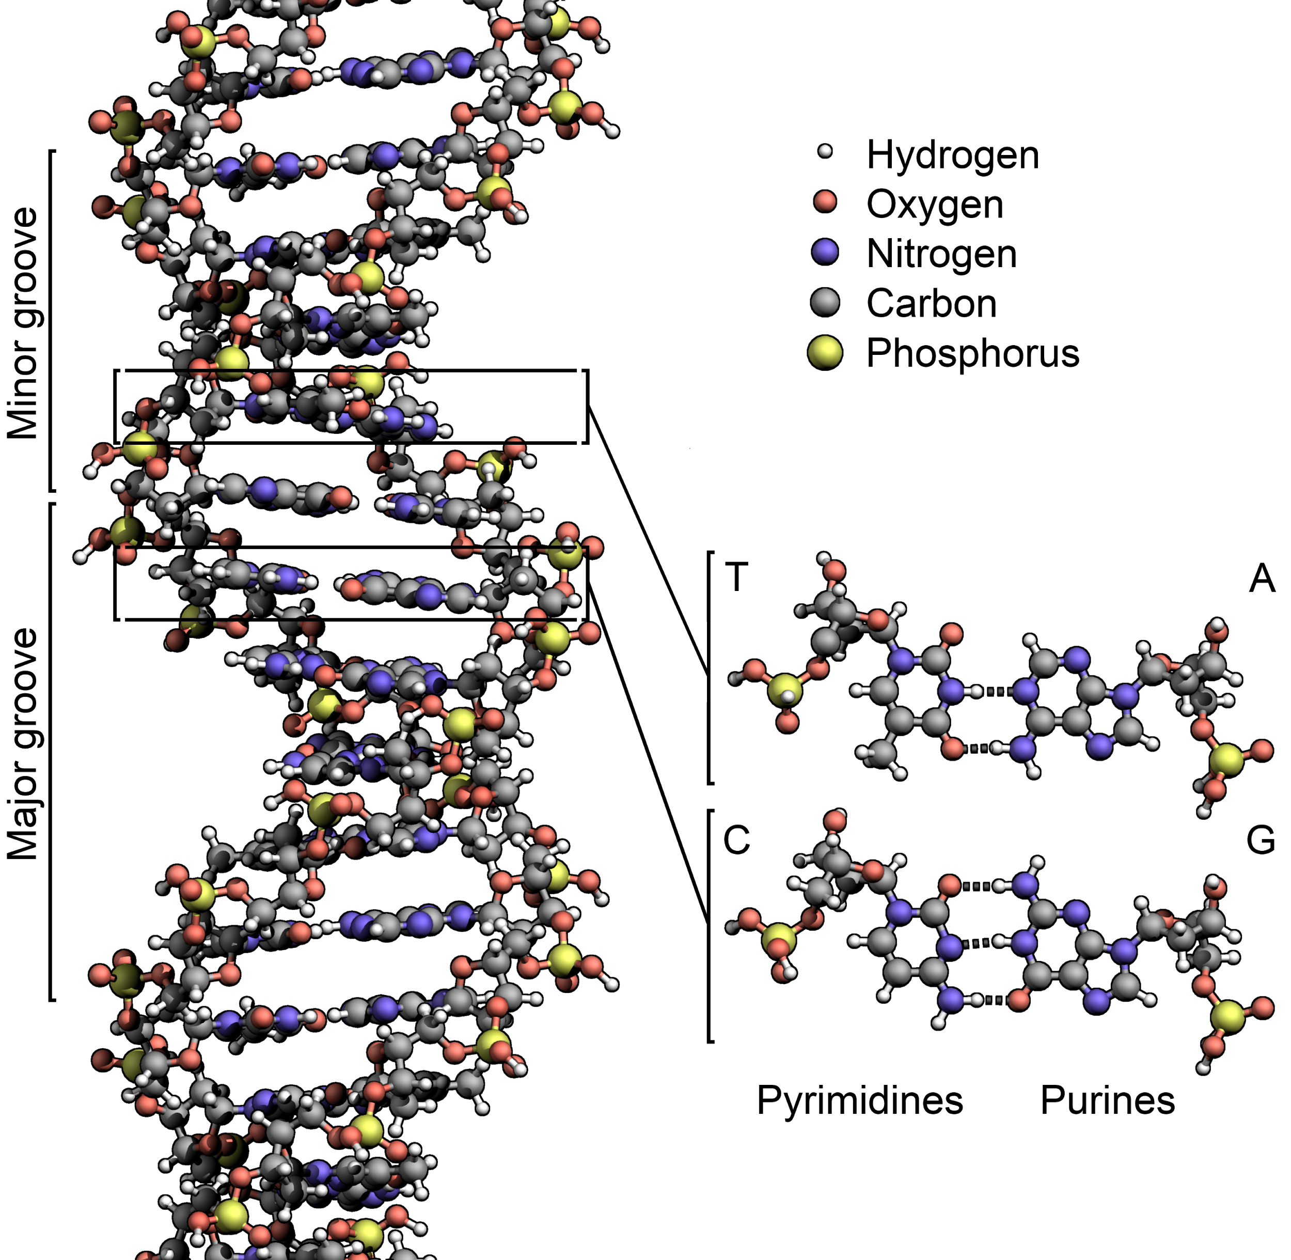
Genetic Algorithms
Solution Pool (Initialization)
Crossover
Mutation
Evaluate
Repeat
Notes:
Crossover - combine two elements (make a solution which mixes the values of the parent solutions)
Mutation - random perturbation

Slide 19
Genetic Algorithms
Solution Pool (Initialization)
Crossover
Mutation
Evaluate
Repeat

Slide 20
Genetic Algorithms
Solution Pool (Initialization)
How many solutions do you need?
Create solutions
Verify they are legitimate (if necessary)
Notes:
Verify if legitimate -- did I just make a car with 100 inch wheels because I took the wheels from a monster truck?
Can my wheel wells support that?
++ did I just make a plane whose pieces can’t fit together/whose engine isn’t powerful enough to take off?

Slide 21
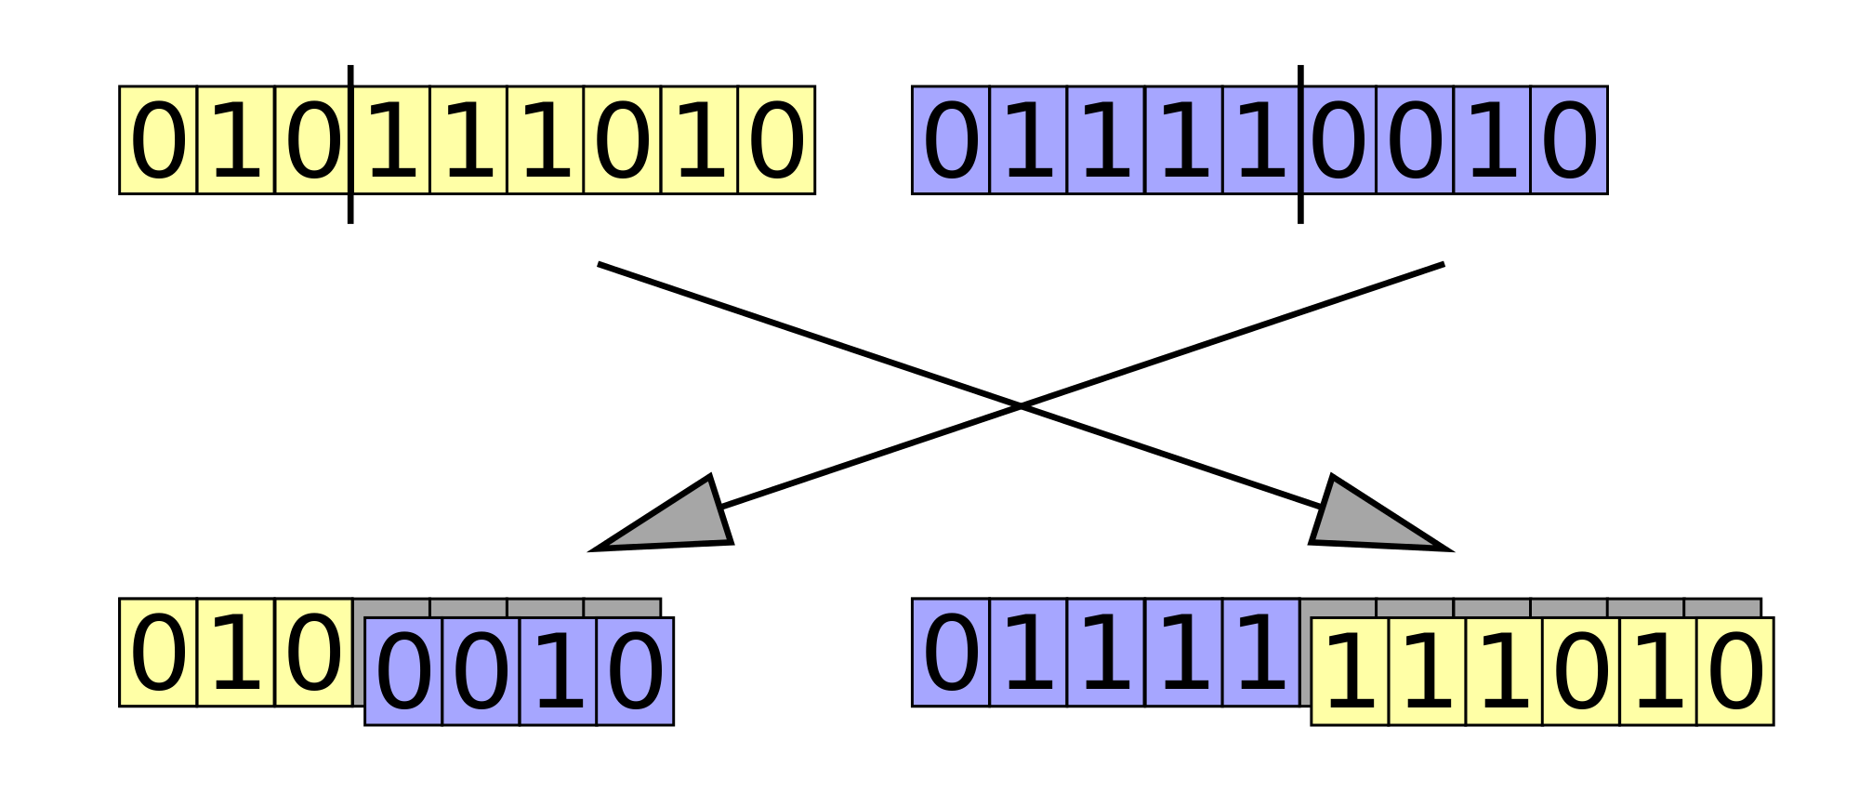
Genetic Algorithms
Crossover
Combine elements of existing solutions to create new options
Notes:
This is how we combine existing pieces to get new things

Slide 22
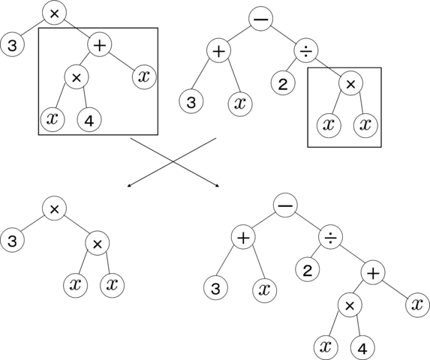
Genetic Algorithms
Crossover
Combine elements of existing solutions to create new options
Notes:
This is how we combine existing pieces to get new things

Slide 23
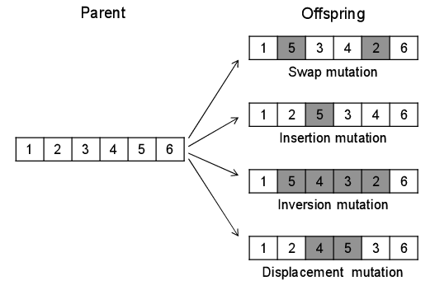
Genetic Algorithms
Mutation
Randomly modify new solution (or randomly don’t)
Notes:
This is how we (hopefully) make random brand-new things

Slide 24
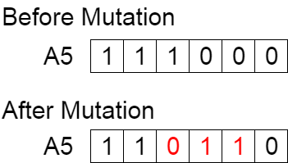
Genetic Algorithms
Mutation
Randomly modify new solution (or randomly don’t)
Notes:
This is how we (hopefully) make random brand-new things

Slide 25
Genetic Algorithms
Evaluate
How good is/are my new solution(s)
Need objective function
Are my new solutions allowable?
Notes:
Allowable: what if you are limited to the domain x between -5 and 5 and you randomly generate x = 6? Or you are at x = 5 and randomly generate the mutation x += 1?
--- then you have created an invalid solution. It must be eliminated.

Slide 26
Differential Evolution
Create random solution pool
Until done:
For each solution
Select 3 more (distinct) solutions at random
Randomly select a dimension
Randomly pick (1) or (2)
New solution = this solution, with i^{th} dimension a combination of solutions in step 2
New solution = this solution
Evaluate new solution, keep if better than old

Slide 27
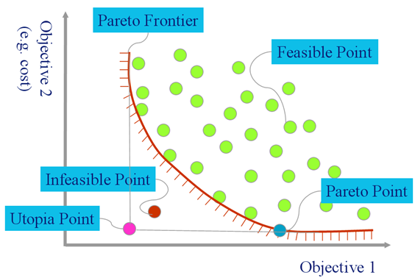
Differential Evolution
https://github.com/txt/mase/blob/master/img/pareto1.png

Slide 28
Differential Evolution
If rand < p:
newSol[i] = P₁ + f*(P₂ - P₃)
Else:
newSol[i] = P₀[i]

Slide 29
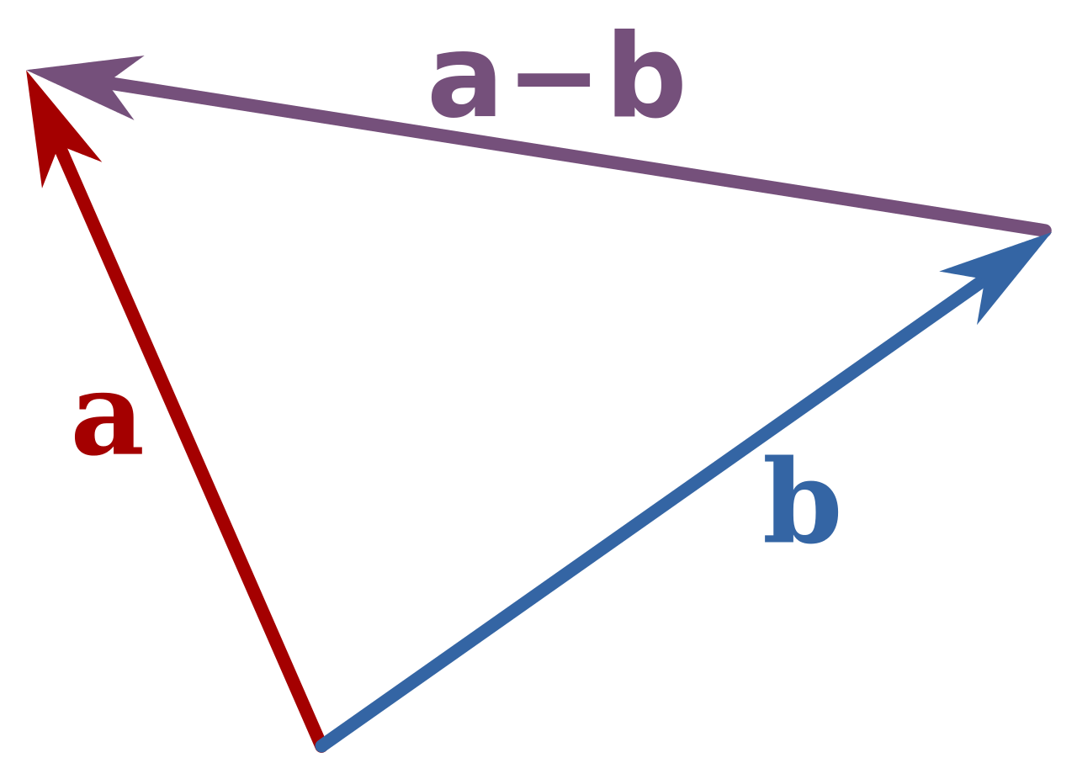
Differential Evolution
newSol[i] = P₁ + f*(P₂ - P₃)
https://en.wikipedia.org/wiki/File:Vector_subtraction.svg

Slide 30
Particle Swarm Optimization
https://urbanautomaton.com/blog/2017/01/19/birds-slowly/

Slide 31
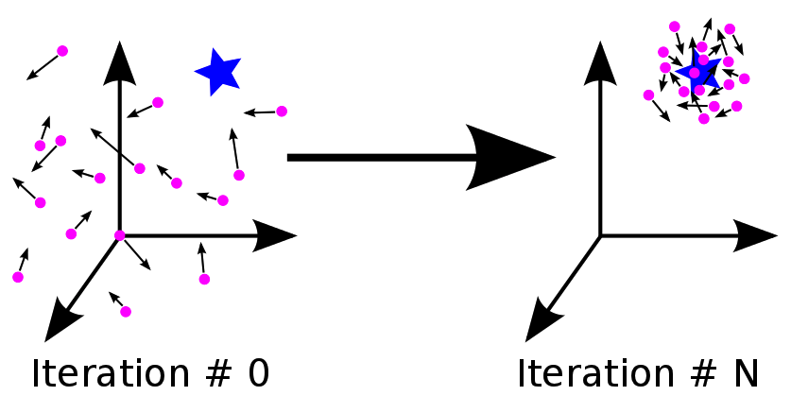
Particle Swarm Optimization
https://medium.com/@iamterryclark/swarm-intelli-eb5e46eda0c3

Slide 32
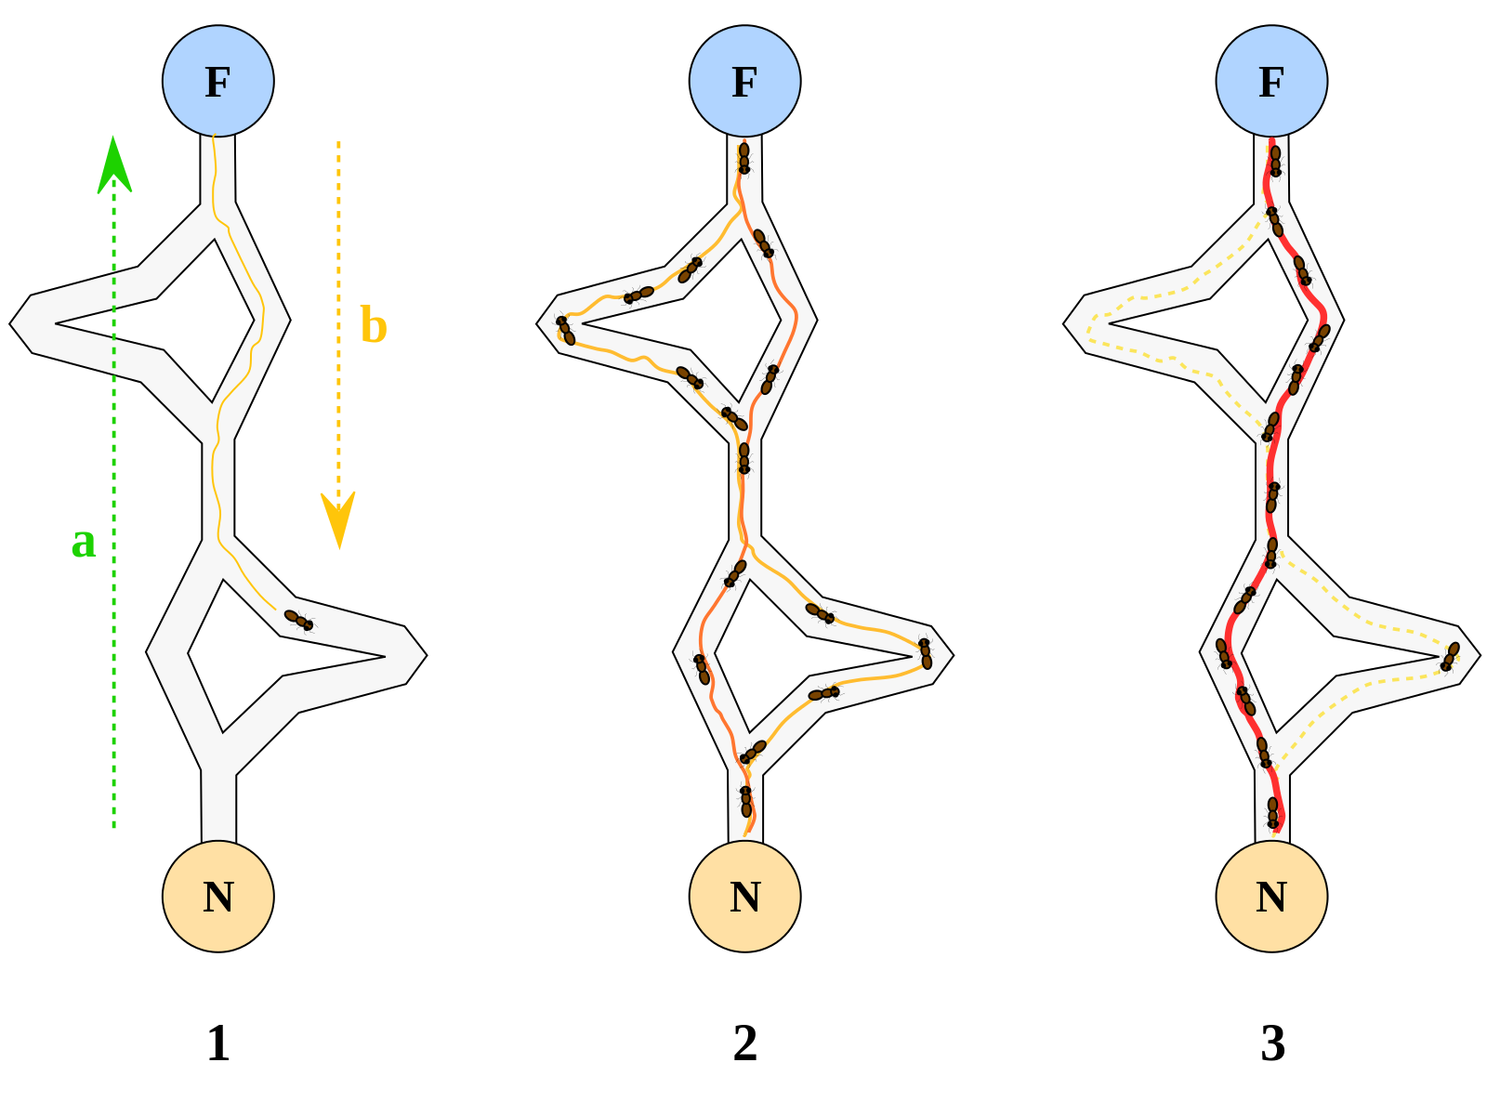
Ant Colony Optimization
Notes:
N: Nest F: Food
1: Marking a trail
2: Following the trails
3: Reinforcing the shortest trail (positive feedback loop)

Slide 33
Pictures
https://commons.wikimedia.org/wiki/File:Computational.science.Genetic.algorithm.Crossover.Cut.and.Splice.svg
https://commons.wikimedia.org/wiki/File:GP_crossover.png
https://www.researchgate.net/figure/Mutation-operators-applied-to-chromosomes-in-the-proposed-genetic-algorithm_fig8_272093243
https://towardsdatascience.com/introduction-to-genetic-algorithms-including-example-code-e396e98d8bf3
https://en.wikipedia.org/wiki/DNA

